Slide 1
Coronary Heart Disease Prediction Using Machine Learning Algorithms
End-Semester Project Presentation
Group 10 – Bug Smashers
CSE523 - Machine Learning
Course Instructor - Dr. Mehul Raval
Moksh Doshi (AU1940028), Jaimik Patel (AU1940120)
Nandish Patel (AU1940130), Jenil Bagadiya (AU1940164)

Slide 2

Introduction
CHDs are one of the major causes of death worldwide with estimates of around 17.9 million deaths in 2019 according to WHO^{#1}
Unhealthy activities like not getting enough sleep, drinking alcohol, consumption of junk food, hypertension, insufficient physical activity,smoking is the reason for the increase in the risk of heart disease
According to American Heart Association person having sleep deprivation, swollen legs and in some cases weight gain occurring speedily (i.e. 1-2 kg daily)
Binary classification problem having 0 as not a heart disease patient and 1 as a patient detected for the future heart disease problem
#1 - Bharti, R., Khamparia, A., Shabaz, M., Dhiman, G., Pande, S. and Singh, P., 2021. Prediction of Heart Disease Using a Combination of Machine Learning and Deep Learning. Computational Intelligence and Neuroscience, 2021, pp.1-11.

Slide 3
Problem Statement
Our goal is to predict whether the patient will have coronary heart disease or not (binary classification) in the future using various different machine learning models.
Used a dataset obtained from Kaggle[1] which consists of 11 different features and 1 target variable. There are a total of 70000 data points in the dataset.
The prediction is made for 1 year in the future
[1] ULIANOVA, S., 2019. Cardiovascular Disease dataset. [online] Kaggle.com. Available at: <https://www.kaggle.com/datasets/sulianova/cardiovascular-disease-dataset> [Accessed 26 March 2022].

Slide 4
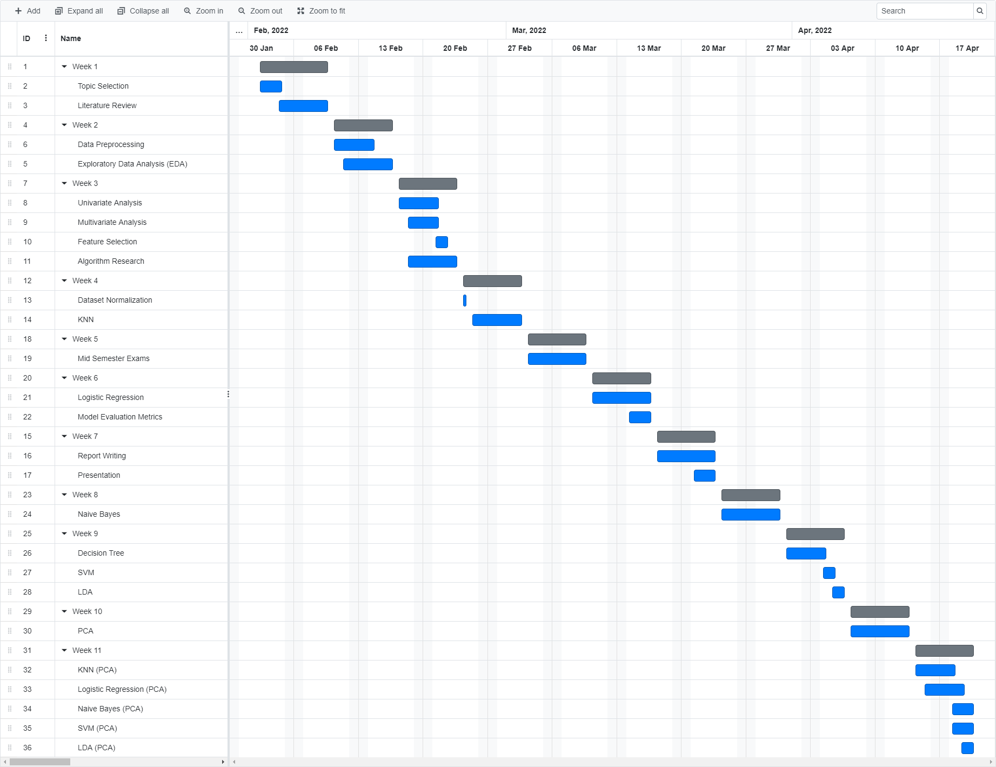
Progress Over Time

Slide 5
Existing Body of Work
The data of heart disease patients collected from the UCI laboratory is used to discover patterns with NN,DT, Support Vector machines SVM, and Naive Bayes. The results are compared for performance and accuracy with these algorithms. The proposed hybrid method returns results of 86.8% for F-measure, competing with the other existing methods in [1]
The various different research techniques considered in this work for prediction and classiﬁcation of heart disease using ML and deep learning (DL) techniques are highly accurate in establishing the efﬁcacy of these methods in [2]
[1] Cheng, C. Chiu, H., 2017. An Artiﬁcial Neural Network Model for the Evaluation of Carotid Artery Stenting Prognosis Using a Nationwide Database. 2017 39th Annual International Conference of the IEEE Engineering in Medicine and Biology Society (EMBC), pp.2566−2569
[2] Ravish, D.K. Shenoy, N.R., 2014. Heart Function Monitoring , Prediction and Prevention of Heart Attacks: Using Artiﬁcial Neural Networks. ,pp.1−6

Slide 6
Our Approach
Data Gathering
Cleaning & Preprocessing
Exploratory Data Analysis
Feature Creation & Selection
Researched various sources
Looked at different available datasets
Finalized a dataset for the project
Removed NaN, duplicate and other erroneous values
Interpolated more data from available data points
Univariate analysis (target variable even distributed b/w 2 classes)
Multivariate Analysis
Age is major factor in determining risk of CHDs
Created BMI from height and weight
Created Mean Arterial Pressure from systolic & diastolic BP
Removed features with less impact on outcome (p-values & correlation matrix)

Slide 7
Our Approach
Train Models
Measure and Compare Accuracy
PCA
Re-train models
Trained on 40,000 out of 52,000 data points (80-20 train test split)
KNN
Logistic
Naive Bayes
Decision Trees
LDA
SVM
Before PCA applied accuracy were
Best case scenario is SVM - 72.67%
Worst case scenario is Decision Tree - 70.63%
Applied PCA for dimensionality reduction and to make certain algorithms more efficient
To observe trends, outliers, and clusters for multivariate model
Re-trained models using all algorithms on PCA transformed data
Accuracy of 71.96% in SVM and 64.3% in Decision trees

Slide 8
Results
Classifier | Test Accuracy | Precision | Recall | F1 score
KNN | 0.7227 | 0.73 | 0.72 | 0.72
Logistic Regression | 0.7201 | 0.72 | 0.72 | 0.72
Naive Bayes | 0.70863 | 0.71 | 0.71 | 0.71
Decision Tree | 0.70639 | 0.71 | 0.71 | 0.70
SVM | 0.72679 | 0.73 | 0.73 | 0.73
LDA | 0.72143 | 0.72 | 0.72 | 0.72

Slide 9
Results - Dimensions Reduced
Classifier | Test Accuracy | Precision | Recall | F1 score
Logistic Regression | 0.7159 | 0.72 | 0.72 | 0.71
Naive Bayes | 0.6883 | 0.70 | 0.69 | 0.68
Decision Tree | 0.6430 | 0.66 | 0.64 | 0.63
SVM | 0.7196 | 0.72 | 0.72 | 0.72
LDA | 0.7150 | 0.72 | 0.72 | 0.71

Slide 10
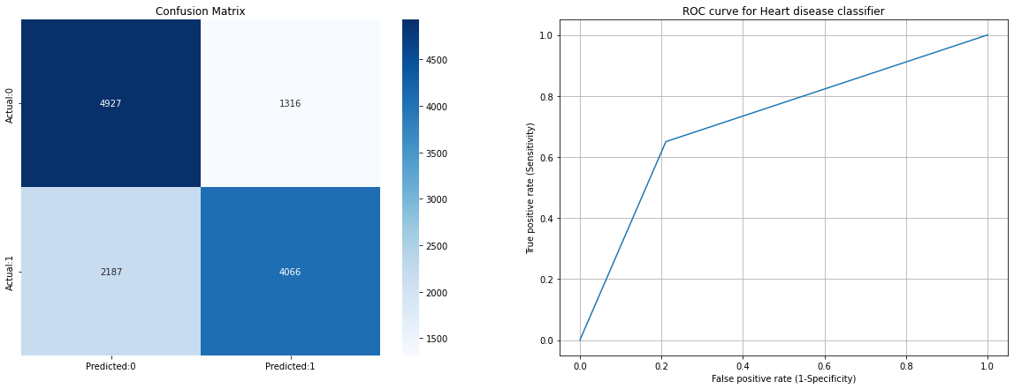
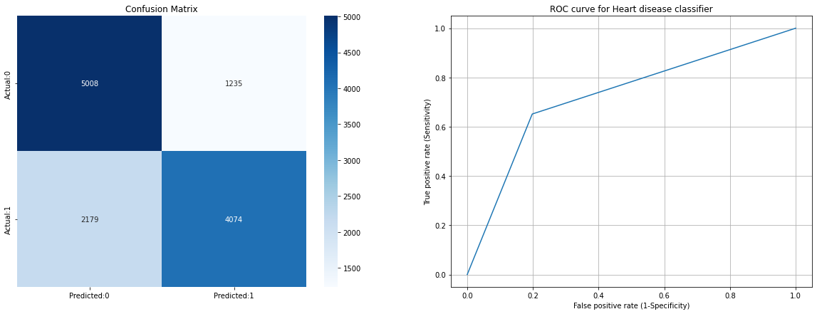
SVM
SVM – Dimensions Reduced
SVM – Original Dataset

Slide 11
Results - SVM
C | Gamma | Accuracy
1 | 0.001 | 0.499
1 | 0.1 | 0.609
10 | 0.1 | 0.684
10 | 1 | 0.694
50 | 1 | 0.694

Slide 12
Conclusion
SVM has the best accuracy of 71.96% on testing dataset among other machine learning algorithms like Logistic Regression, Naive Bayes, Decision tree, LDA
Early detection of heart diseases not only benefits to patient but also helps the medical institutes to know about their resources distribution and also helps to in the prevention of the diseases
ML algorithms can decipher complex pattern in the data leading to a possibility of early prediction, diagnosis and cure

Slide 13
Role of each group member in the project
 | Exploratory Data Analysis | Data pre-processing | Algorithm Implementation | Dimensionality Reduction & re-train | SVM - Deep Dive | Literature Review and Reports
Moksh | ✔ |  | ✔ |  | ✔ | ✔
Jaimik | ✔ | ✔ | ✔ |  |  | ✔
Nandish |  | ✔ | ✔ | ✔ |  | ✔
Jenil | ✔ |  | ✔ | ✔ |  | ✔

Slide 14
References
R. Bharti, A. Khamparia, M. Shabaz, G. Dhiman, S. Pande, and P. Singh, “Prediction of Heart Disease Using a Combination of Machine Learning and Deep Learning,” Computational Intelligence and Neuroscience, vol. 2021. Hindawi Limited, pp. 1–11, Jul. 01, 2021. doi: 10.1155/2021/8387680.
N. Rajesh, M. T, S. Hafeez, and H. Krishna, “Prediction of Heart Disease Using Machine Learning Algorithms,” International Journal of Engineering & Technology, vol. 7, no. 2.32. Science Publishing Corporation, p. 363, May 31, 2018. doi: 10.14419/ijet.v7i2.32.15714
S. Ulianova, “Cardiovascular disease dataset,” Kaggle, 20-Jan-2019. [Online]. Available: https://www.kaggle.com/datasets/sulianova/cardiovascular-disease-dataset. [Accessed: 19-Mar-2022].
D. Shah, S. Patel, and S. K. Bharti, “Heart disease prediction using Machine Learning Techniques,” SN Computer Science, vol. 1, no. 6, 2020.
Mohan, Senthilkumar & Thirumalai, Chandra Segar & Srivastava, Gautam. (2019). Effective Heart Disease Prediction Using Hybrid Machine Learning Techniques. IEEE Access. PP. 1-1. 10.1109/ACCESS.2019.2923707.
Almustafa, K., 2020. Prediction of heart disease and classifiers’ sensitivity analysis. BMC Bioinformatics, 21(1).

